Slide 1
CS50102:: INTERNET TECHNOLOGIES
Prepared by
Prof Debabrata Swain

Slide 2
What is HTML?
HTML is a markup language for describing web documents (web pages).
HTML stands for Hyper Text Markup Language
A markup language is a set of markup tags
HTML documents are described by HTML tags
Each HTML tag describes different document content
Markup refers to the sequence of characters or other symbols that you insert at certain places in a text or word processing file to indicate how the file should look when it is printed or displayed or to describe the document's logical structure. The markup indicators are often called "tags."

Slide 3
www
The Web, or World Wide Web, is basically a system of Internet servers that support specially formatted documents. The documents are formatted in a markup language called HTML (Hyper Text Markup Language) that supports links to other documents, as well as graphics, audio, and video files.
This means you can jump from one document to another simply by clicking on hot spots. Not all Internet servers are part of the World Wide Web. There are several applications called Web browsers that make it easy to access the World Wide Web; Two of the most popular being Firefox and Google chrome.

Slide 4
W3C
Word Wide Web consortium decided to developing nor proprietary, interoperable technologies for the world wide web. The primary goal is to make the web universally accessible – regardless of ability, language or culture.
The WSC is also a standardization organization. Web technologies standardized by the WSC are called Recommendations which is a document that specifies a technology’s role, syntax rules.
The W3C is an industry consortium which seeks to promote standards for the evolution of the Web and interoperability between WWW products by producing specifications and reference software. Although W3C is funded by industrial members, it is vendor-neutral, and its products are freely available to all.

Slide 5
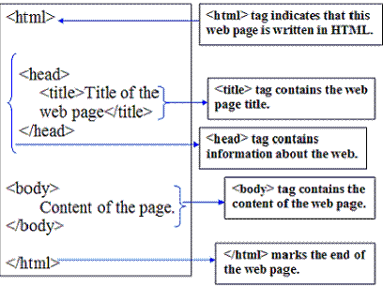
HTML WEB PAGE STRUCTURE

Slide 6
A small HTML document:
<!DOCTYPE html>
<html>
<head>
<title>Page Title</title>
</head>
<body>
<h1>My First Heading</h1>
<p>My first paragraph.</p>
</body>
</html>

Slide 7
How to create and run html file
1. Write some html code in notepad/notepad++
2. Save the file with extension .html or .htm
3. Open the file in browser

Slide 8
Example Explained
The DOCTYPE declaration defines the document type to be HTML
The text between <html> and </html> describes an HTML document
The text between <head> and </head> provides information about the document
The text between <title> and </title> provides a title for the document
The text between <body> and </body> describes the visible page content
The text between <h1> and </h1> describes a heading
The text between <p> and </p> describes a paragraph
Using this description, a web browser can display a document with a heading and a paragraph.

Slide 9
Commonly Used HTML Tags
Provides an introduction to basic HTML coding.
HTML Tags
Header tags
HTML Code | Sample
<H1>Header 1</H1> | Header 1
<H2>Header 2</H2> | Header 2
<H3>Header 3</H3> | Header 3
<H4>Header 4</H4> | Header 4
<H5>Header 5</H5> | Header 5
<H6>Header 6</H6> | Header 6

Slide 10
text
Text formatting tags
HTML Code | Sample
<B>bold</B> | bold
<U>underline</U> | underline
<I>italic</I> | italic
Alignment tags
HTML Code | Sample
<P ALIGN=Left>your text | your text
<P ALIGN=Center>your text | your text
<P ALIGN=Right>your text | your text

Slide 11
Break tags
HTML Code | Description
<P> | Paragraph break
<BR> | Forced line break

Slide 12
Character Tags
A tag that you apply to an individual character is referred to as a character tag. There are two types of character tags, physical and logical.
Physical Tags
Physical tags are used to indicate exactly how specific characters are to be formatted.
The syntax or format for using a PHYSICAL TAG is as follows:
<Tag Name> Characters to be formatted. </Tag Name>

Slide 13
<B> | Indicates that the text should be bold. | </B>
<I> | Indicates that the text should be italic. | </I>
<TT> | Indicates that the text should be used with a font such as Courier that allots the same width to each character. | </TT>
<BIG> | Indicates that the text should be displayed in a big font. Available in HTML 3.0 or higher. | </BIG>
<SMAL> | Indicates that the text should be displayed in a small font. Available in HTML 3.0 or higher. | </SMALL>
<SUB> | Indicates that the text should be displayed as a _{subscript}, in a smaller font if possible. Available in HTML 3.0 or higher. | </SUB>
<SUP> | Indicates that the text should be displayed as a ^{superscript}, in a smaller font if possible. Available in HTML 3.0 or higher. | </SUP>
<U> | Indicates that the text should be displayed underlined. Not all browsers support this tag. | </U>
<B> | Indicates that the text should be bold. | </B>

Slide 14
Logical Tags
Logical tags are used to indicate to the visually impaired that there is some emphasizes on the text. Each browser has its own technique as to how to indicate to its viewer that the text between the tags are different.
The syntax or format for using a LOGICAL TAG is as follows:
<Tag Name> Character/s to be formatted. </Tag Name>

Slide 15
<EM> | Indicates that characters should be emphasized in some way. Usually displayed in italics. | </EM>
<STRONG> | Emphasizes characters more strongly than <EM>. Usually displayed in a bold font | </STRONG>
<CODE> | Indicates a sample of code. Usually displayed in a Courier font or a similiar font that allots the same width to each character. | </CODE>
<KBD> | Used to offset text that the user should enter. Often displayed in a Courier font or a similar font that allots the same width to each character. | </KBD>
<VAR> | Indicates a variable. Often displayed in italics or underlined. | </VAR>
<CITE> | Indicates short quotes or citations. Often italized by browsers. | </CITE>

Slide 16
HTML Element Syntax
An HTML element starts with a start tag <> opening tag
An HTML element ends with an end tag </> closing tag
The element content is everything between the start and the end tag
Some HTML elements have empty content
Empty elements are closed in the start tag
Most HTML elements can have attributes
Nested HTML Elements
Most HTML elements can be nested (can contain other HTML elements).
HTML documents consist of nested HTML elements.
HTML Document Example
<!DOCTYPE html>
<html>
<body>
<p>This is my first paragraph.</p>
</body>
</html>

Slide 17
The example above contains 3 HTML elements.
HTML Example Explained
The <p> element:
<p>This is my first paragraph.</p>
The <p> element defines a paragraph in the HTML document.
The element has a start tag <p> and an end tag </p>.
The element content is: This is my first paragraph.
The <body> element:
<body>
<p>This is my first paragraph.</p>
</body>
The <body> element defines the body of the HTML document.
The element has a start tag <body> and an end tag </body>.
The element content is another HTML element (a p element).
The <html> element:
<html>
<body>
<p>This is my first paragraph.</p>
</body>
</html>

Slide 18
The <html> element defines the whole HTML document.
The element has a start tag <html> and an end tag </html>.
The element content is another HTML element (the body element).
Don't Forget the End Tag
Some HTML elements might display correctly even if you forget the end tag:
<p>This is a paragraph
<p>This is a paragraph
The example above works in most browsers, because the closing tag is considered optional.
Never rely on this. Many HTML elements will produce unexpected results and/or errors if you forget the end tag .
Empty HTML Elements
HTML elements with no content are called empty elements.
<br> is an empty element without a closing tag (the <br> tag defines a line break).

Slide 19
Tip: In XHTML, all elements must be closed. Adding a slash inside the start tag, like <br />, is the proper way of closing empty elements in XHTML (and XML).
HTML Tip: Use Lowercase Tags
HTML tags are not case sensitive: <P> means the same as <p>. Many web sites use uppercase HTML tags.
Tag Description
<html>Defines an HTML document
<body>Defines the document's body
<h1> to <h6>Defines HTML headings
<hr>Defines a horizontal line
<!-->Defines a comment

Slide 20
Changing background color of page
The background-color property defines the background color for an element:
<!DOCTYPE html>
<html>
<body style="background-color:yellow;">
<h2 style="background-color:red;">This is a heading</h2>
<p style="background-color:green;">This is a paragraph.</p>
</body>
</html>

Slide 21
<html>
<body bgcolor=“#E6E6FA”>
<h1>Hello World</h1>
<p><a href="http://www.w3schools.com">VisitW3schools.com!</a></p>
</body>
</html>

Slide 22
HTML <font> color Attribute
HTML <font> tag
Example
Specify the color of text:
<font color="red">This is some text!</font>
Ex-
<!DOCTYPE html>
<html>
<body>
<p><font color="red">This is some text!</font></p>
<p><font color="blue">This is some text!</font></p>
<p>The color attribute is not supported in HTML5. Use CSS instead.</p>
</body>
</html>

Slide 23
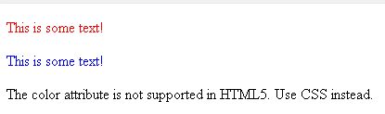

Slide 24
<hr> tag
Use the <hr> tag to define a thematic change in the content:
<!DOCTYPE html>
<html>
<body>
<h1>HTML</h1>
<p>HTML is a language for describing web pages.</p>
<hr>
<h1>CSS</h1>
<p>CSS defines how to display HTML elements.</p>
</body>
</html>

Slide 25
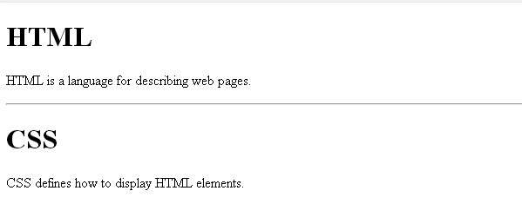

Slide 26
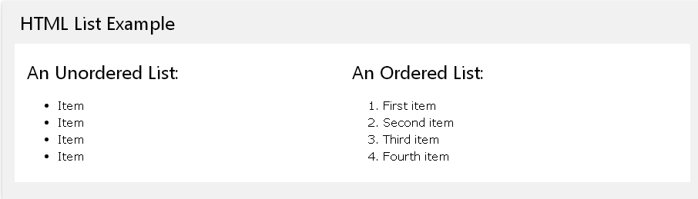

Slide 27
Unordered HTML List
An unordered list starts with the <ul> tag. Each list item starts with the <li> tag.
The list items will be marked with bullets (small black circles) by default:
Ex-
<ul>
<li>Coffee</li>
<li>Tea</li>
<li>Milk</li>
</ul>
An unordered HTML list
Coffee
Tea
Milk

Slide 28
Unordered HTML List - Choose List Item Marker
The CSS list-style-type property is used to define the style of the list item marker:
Value | Description
disc | Sets the list item marker to a bullet (default)
circle | Sets the list item marker to a circle
square | Sets the list item marker to a square
none | The list items will not be marked
Value | Description

Slide 29
Example – Disc
<ul style="list-style-type:disc">
<li>Coffee</li>
<li>Tea</li>
<li>Milk</li>
</ul>
Unordered List with Disc Bullets
Coffee
Tea
Milk

Slide 30
Ordered HTML List
An ordered list starts with the <ol> tag. Each list item starts with the <li> tag.
The list items will be marked with numbers by default:
Ex-
<h2>An ordered HTML list</h2>
<ol>
<li>Coffee</li>
<li>Tea</li>
<li>Milk</li>
</ol>
An ordered HTML list
1.Coffee
2.Tea
3.Milk

Slide 31
Ordered HTML List - The Type Attribute
The type attribute of the <ol> tag, defines the type of the list item marker:
Type | Description
type="1" | The list items will be numbered with numbers (default)
type="A" | The list items will be numbered with uppercase letters
type="a" | The list items will be numbered with lowercase letters
type="I" | The list items will be numbered with uppercase roman numbers
type="i" | The list items will be numbered with lowercase roman numbers

Slide 32
<!DOCTYPE html>
<html>
<body>
<h2>Ordered List with Numbers</h2>
<ol type="1">
<li>Coffee</li>
<li>Tea</li>
<li>Milk</li>
</ol>
</body>
</html>
Ordered List with Numbers
1.Coffee
2.Tea
3.Milk

Slide 33
HTML Images - The <img> Tag and the Src Attribute
In HTML, images are defined with the <img> tag.
The <img> tag is empty, which means that it contains attributes only, and has no closing tag.
To display an image on a page, you need to use the src attribute. Src stands for "source". The value of the src attribute is the URL of the image you want to display.
Syntax for defining an image:
<img src="url" alt="some_text">
The URL points to the location where the image is stored. An image named "boat.gif", located in the "images" directory on "www.w3schools.com" has the URL:

Slide 34
http://www.w3schools.com/images/boat.gif.
The browser displays the image where the <img> tag occurs in the document. If you put an image tag between two paragraphs, the browser shows the first paragraph, then the image, and then the second paragraph.
HTML Images - The Alt Attribute
The required alt attribute specifies an alternate text for an image, if the image cannot be displayed.
The value of the alt attribute is an author-defined text:
<img src="smiley.gif" alt="Smiley face">
The alt attribute provides alternative information for an image if a user for some reason cannot view it (because of slow connection, an error in the src attribute, or if the user uses a screen reader).

Slide 35
HTML Images - Set Height and Width of an Image
The height and width attributes are used to specify the height and width of an image.
The attribute values are specified in pixels by default:
<img src="smiley.gif" alt="Smiley face" width="42" height="42">
Tip: It is a good practice to specify both the height and width attributes for an image. If these attributes are set, the space required for the image is reserved when the page is loaded. However, without these attributes, the browser does not know the size of the image. The effect will be that the page layout will change during loading (while the images load).

Slide 36
image links
<!DOCTYPE html>
<html>
<body>
<p>
An image as a link: <a href="http://www.google.com">
<img border="0" alt=“Debabrata" src="C:\Documents and Settings\Administrator\Desktop\image\img.jpg" width="100" height="100">
</a>
</p>
</body>
</html>

Slide 37


Slide 38
Image mapping
The <map> tag is used to define a client-side image-map. An image-map is an image with clickable areas.
The required name attribute of the <map> element is associated with the <img>'s usemap attribute and creates a relationship between the image and the map.
The <map> element contains a number of <area> elements, that defines the clickable areas in the image map.

Slide 39
<!DOCTYPE html>
<html>
<body>
<p>Click on the sun or on one of the planets to watch it closer:</p>
<img src="planets.gif" width="145" height="126" alt="Planets" usemap="#planetmap">
<map name="planetmap">
<area shape="rect" coords="0,0,82,126" alt="Sun" href="sun.htm">
<area shape="circle" coords="90,58,3" alt="Mercury" href="mercur.htm">
<area shape="circle" coords="124,58,40" alt="Venus" href="venus.htm">
</map>
</body>
</html>

Slide 40
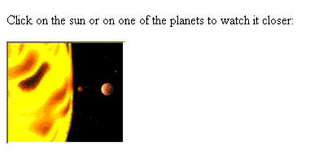




Slide 41
Tables
Defining an HTML Table
An HTML table is defined with the <table> tag.
Each table row is defined with the <tr> tag. A table header is defined with the <th> tag. By default, table headings are bold and centered. A table data/cell is defined with the <td> tag.

Slide 42
<!DOCTYPE html>
<html>
<body>
<table style="width:100%">
<tr>
<th>Firstname</th>
<th>Lastname</th>
<th>Age</th>
</tr>
<tr>
<td>Jill</td>
<td>Smith</td>
<td>50</td>
</tr>

Slide 43
<tr>
<td>Eve</td>
<td>Jackson</td>
<td>94</td>
</tr>
<tr>
<td>John</td>
<td>Doe</td>
<td>80</td>
</tr>
</table>
</body>
</html>

Slide 44
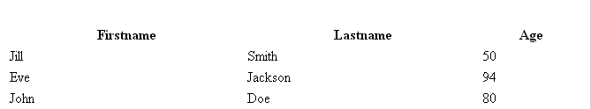

Slide 45
<!DOCTYPE html>
<html>
<head>
<style>
table, th, td {
border: 1px solid black;
}
</style>
</head>
<body>
<table style="width:100%">
<tr>
<th>Firstname</th>
<th>Lastname</th>
<th>Age</th>
</tr>

Slide 46
<tr>
<td>Jill</td>
<td>Smith</td>
<td>50</td>
</tr>
<tr>
<td>Eve</td>
<td>Jackson</td>
<td>94</td>
</tr>
<tr>
<td>John</td>
<td>Doe</td>
<td>80</td>
</tr>
</table>
</body>
</html>

Slide 47
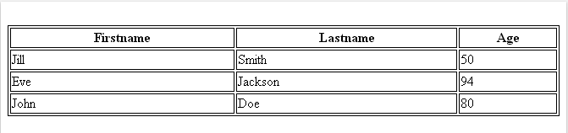

Slide 48
Frames
Definition and Usage
The <frameset> tag is not supported in HTML5.
The <frameset> tag defines a frameset.
The <frameset> element holds one or more <frame> elements. Each <frame> element can hold a separate document.
The <frameset> element specifies HOW MANY columns or rows there will be in the frameset, and HOW MUCH percentage/pixels of space will occupy each of them.
Note: If you want to validate a page containing frames, be sure the <!DOCTYPE> is set to either "HTML Frameset DTD" or "XHTML Frameset DTD".

Slide 49
<!DOCTYPE html>
<html>
<frameset cols="25%,*,25%">
<frame src="frame_a.htm">
<frame src="frame_b.htm">
<frame src="frame_c.htm">
</frameset>
</html>

Slide 50
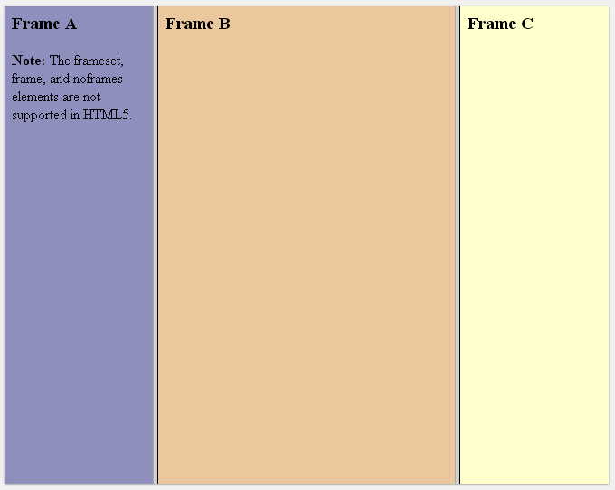

Slide 51
HTML Forms and Input
HTML Forms are used to select different kinds of user input.
HTML forms are used to pass data to a server.
An HTML form can contain input elements like text fields, checkboxes, radio-buttons, submit buttons and more. A form can also contain select lists, text area, field set, legend, and label elements.
The <form> tag is used to create an HTML form:
<form>
input elements
</form>

Slide 52
HTML Forms - The Input Element
The most important form element is the <input> element.
The <input> element is used to select user information.
An <input> element can vary in many ways, depending on the type attribute. An <input> element can be of type text field, checkbox, password, radio button, submit button, and more.
The most common input types are described below.
Text Fields
<input type="text"> defines a one-line input field that a user can enter text into:
<form>
First name: <input type="text" name="firstname"><br>
Last name: <input type="text" name="lastname">
</form>

Slide 53


Note: The form itself is not visible. Also note that the default width of a text field is 20 characters.
Password Field
<input type="password"> defines a password field:
<form>
Password: <input type="password" name="pwd">
</form>
Note: The characters in a password field are masked (shown as asterisks or circles).

Slide 54

Radio Buttons
<input type="radio"> defines a radio button. Radio buttons let a user select ONLY ONE of a limited number of choices:
<form>
<input type="radio" name="sex" value="male">Male<br>
<input type="radio" name="sex" value="female">Female
</form>

Slide 55

Checkboxes
<input type="checkbox"> defines a checkbox. Checkboxes let a user select ZERO or MORE options of a limited number of choices.
<form>
<input type="checkbox" name="vehicle" value="Bike">I have a bike<br>
<input type="checkbox" name="vehicle" value="Car">I have a car
</form>

Slide 56

Submit Button
<input type="submit"> defines a submit button.
A submit button is used to send form data to a server. The data is sent to the page specified in the form's action attribute. The file defined in the action attribute usually does something with the received input:
<form name="input" action="html_form_action.asp" method="get">
Username: <input type="text" name="user">
<input type="submit" value="Submit">
</form>

Slide 57
HTML <button> Tag
Definition and Usage
The <button> tag defines a clickable button.
Inside a <button> element you can put content, like text or images. This is the difference between this element and buttons created with the <input> element.
Tip: Always specify the type attribute for a <button> element. Different browsers use different default types for the <button> element.
<!DOCTYPE html>
<html>
<body>
<button type="button" onclick="alert('Hello world!')">Click Me!</button>
</body>
</html>

Slide 58
<!DOCTYPE html>
<html>
<body>
<form action="demo_form.asp" method="get">
First name: <input type="text" name="fname"><br>
Last name: <input type="text" name="lname"><br>
<button type="submit" value="Submit">Submit</button>
<button type="reset" value="Reset">Reset</button>
</form>
</body>
</html>

Slide 59
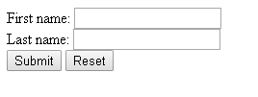

Slide 60
Drop down list
Create a drop-down list with four options:
<!DOCTYPE html>
<html>
<body>
<select>
<option value="volvo">Volvo</option>
<option value="saab">Saab</option>
<option value="opel">Opel</option>
<option value="audi">Audi</option>
</select>
</body>
</html>

